Slide 1

CSCI-3753: Operating Systems Fall 2019
Biljith Thadichi
Department of Computer Science University of Colorado Boulder
Slides based on presentation by Abigail Fernandes

Slide 2
Week 7
> Programming Assignment 3

Slide 3
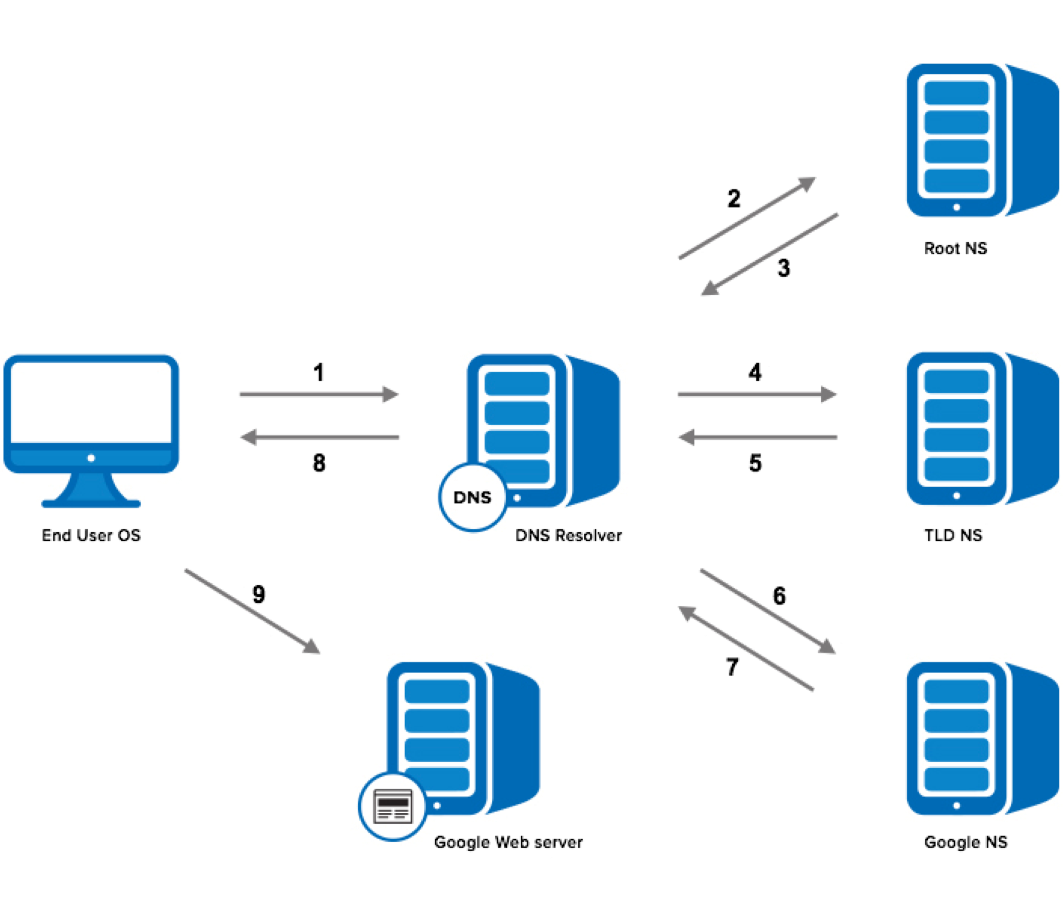
Overview
Domain Name
IP Address

Slide 4
Overview
GOAL: Use PThreads to code a DNS Name Resolution Engine
REQUIREMENTS
Process multiple files
Requesters
Get the next line from a file
Parse the line to extract the domain name
Place the domain name in a shared buffer
Record the processing in a file
Resolvers
Get the next request (domain name) from the shared buffer
Do a look up of the IP address based on the domain name
Log the information into the output file

Slide 5
Overview
For every file
For every line in the file
Parse line to get domain names
For every domain name
Find the corresponding IP address Write information to the output file

Slide 6



Overview
Total runtime is …
Read data from multiple files.
Requester Thread Pool
stdout
gettimeofday()
P
P
C
C
Resolver Thread Pool
Look up the required information for the request, log the results
util.c util.h
. . .
Shared Buffer
. .
Conversion log
Data files facebook.com
youtube.com yahoo.com
Parsing log
Store a single request in an entry of a shared buffer of given size
input/name*.txt
Each line is a request that must be processed individually.
results.txt
Record which process handled which request
Each bordering line is around a shared resource that must be protected from race conditions.
serviced.txt

Slide 7
Program Inputs
./multi-lookup 5 10 requester_log.txt results.txt name1.txt name2.txt
Number of requester threads to place into the thread pool
Number of resolver threads to place into the thread pool
Parsing Logs: The file into which all the parser status information is written
Per line format: Thread <Thread ID> serviced ## files
pthread_self()
Conversion Logs: The file into which all the converter status information is written
Per line format: www.google.com, 74.125.224.81
Data files: List of filenames that are to be processed. Each file contains a list of domain names, one per line, that need to be resolved.

Slide 8
Program Limits
MAX_INPUT_FILES = 10
MAX_RESOLVER_THREADS = 10
MAX_REQUESTOR_THREADS = 5
MAX_DOMAIN_NAME_LENGTH = 1025 characters
MAX_IP_LENGTH = INET6_ADDRSTRLEN or 46

Slide 9
Error Handling
“I didn’t run into any bugs in testing, so there are no bugs…right?”
If the domain name cannot be resolved:
Output a blank string in the format “,”
Print a message to stderr alerting the user
If output file path is bad:
Print an appropriate message to stderr
Exit the program (gracefully!)
If input file path is bad:
Print an appropriate error to stderr
Move on to the next file

Slide 10
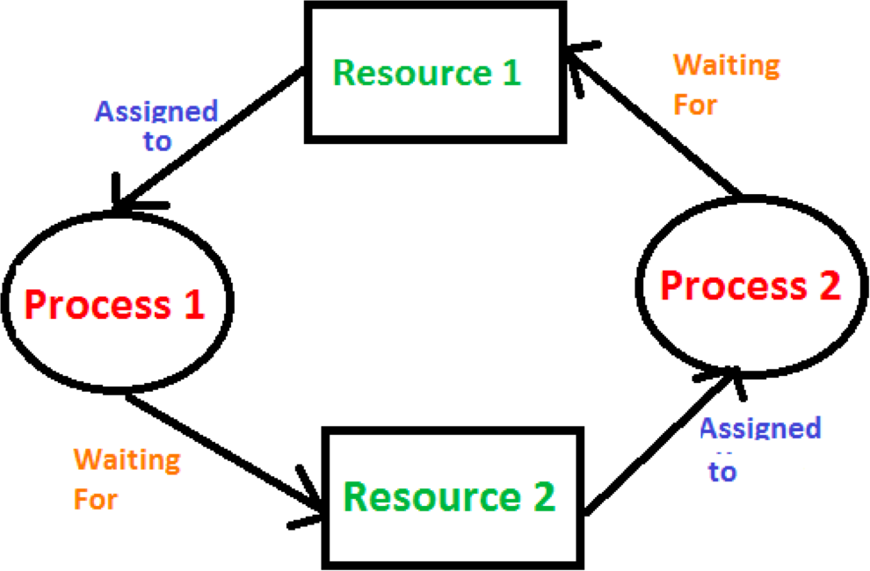
Program Focus
Synchronization (of access to shared resources)
Avoid Deadlocks / Busy wait
Suggested Solutions
Mutex
Semaphores
Conditional Variables

Slide 11


















Slide 12


Implementation – Step 1
TO DO
Write a simple program that creates a thread for parsing. This thread will repeatedly read a line from a given file and add an entry into the shared buffer
VALIDATE
Does the buffer have the correct number of entries?
Shared Buffer

Slide 13



Implementation - Step 2
TO DO
Now you will use your result from Step 1. Once you have completed that step, start a conversion thread to take items out of the shared buffer. Then write the results to an output file.
VALIDATE
Does the output file contain the entries stored in the buffer?
Main Thread start P
wait P
start C wait C
Requester Thread Pool
Resolver Thread Pool
Output File
Shared Buffer

Slide 14

Implementation - Step 3
TO DO
Once you’re sure that your application can read from and write to the the buffer correctly (albeit serially), now try to make it concurrent.
Multiple processes can now access and modify the same data. This can result in race conditions.
You will need to protect the critical sections of each thread with a mutex.
Main Thread
Requester Thread Pool Resolver Thread Pool
start P
start C wait P
wait C – exits
when no data and no active P
Shared Buffer
Output File

Slide 15
Implementation - Step 4
TO DO
Create multiple parsing threads to read from multiple different files. Each parsor can read single lines from a different file. The parsing thread will terminate only when all lines from the file have been processed
Main Thread For each P
start P start C
For each P wait P
wait C
Requester Thread Pool Resolver Thread Pool
Shared Buffer
Output File

Slide 16

Implementation - Step 5
TO DO
Create multiple converter threads to read from multiple parsing threads via the single shared buffer.
The converter will wait for data (spin wait is acceptable) but will terminate if there are no active parsing threads and the buffer is empty.
Main Thread
For each P
start P
For each C
start C
For each P
wait P
For each C
wait C
Resolver Thread Pool Shared Buffer _{Output File}
Requester Thread Pool

Slide 17


Implementation - Step 6
TO DO
Move back to the parsing threads. Each thread must record the data it has processed.
Files are a shared resource and therefore must be protected from multiple processes that are accessing it.
Main Thread
For each P
start P
For each C
start C
For each P
wait P
For each C
wait C
Check P log file
Requester Thread Pool
Resolver Thread Pool
Shared Buffer
Output File
Parsing log

Slide 18
Check Memory Leaks (in your code)
To verify that your code does not result in any memory leaks, use
valgrind() to test your code.
To install valgrind(), run the following command:
sudo apt-get install valgrind
To use valgrind() to monitor your program, use this command:
valgrind ./pa3main ……… text1.text textN.txt

Slide 19
Week 8 Checklist
Complete Quiz
Prepare for midterm
Start PA3 (I’m really looking out for you here!!)

Slide 20


Half way there??
PA 1
PA 2
PA 3
PA 4

